Slide 1
COMP90054 AI Planning for Autonomy
Workshop Week2

Slide 2
Objectives
This week
Strips
PDDL

Slide 3
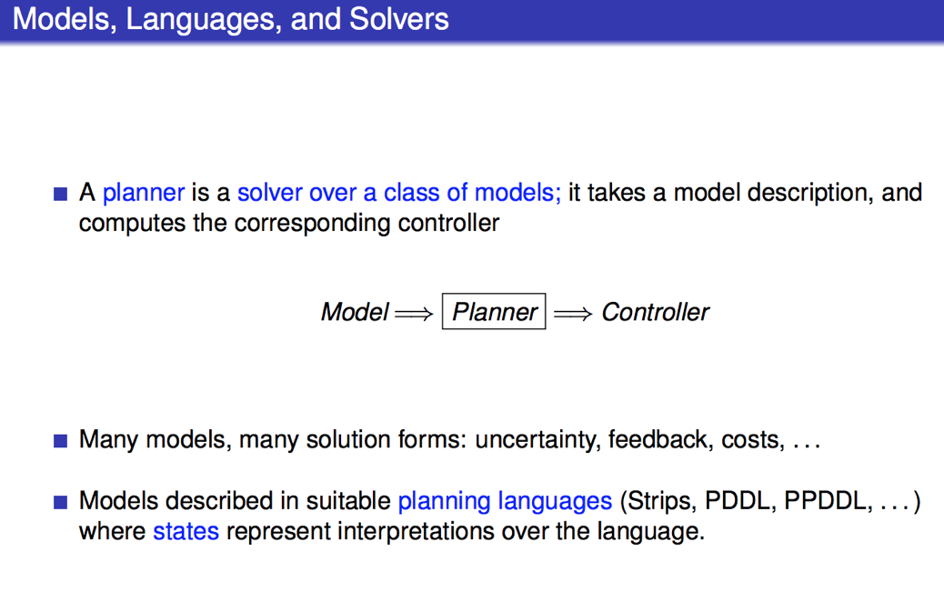

Slide 4
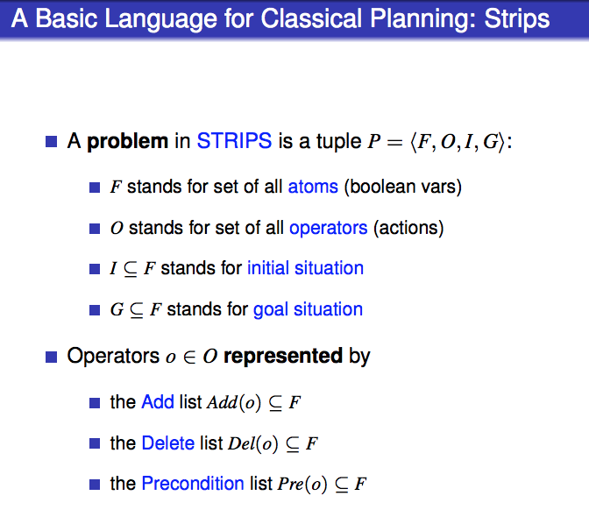

Slide 5
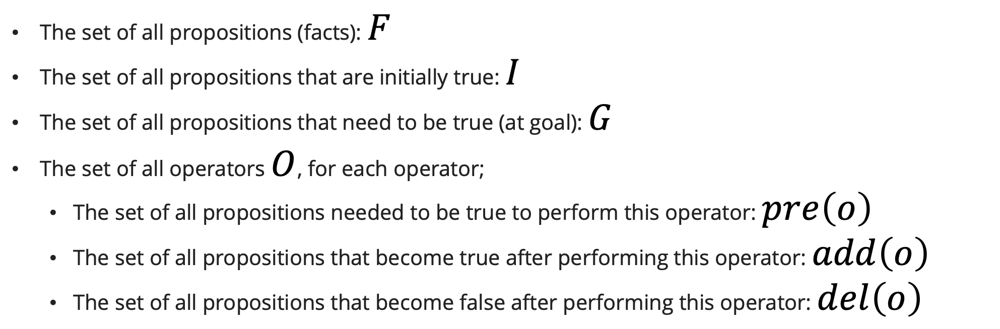
STRIPS
The set of all propositions (facts): $F$
The set of all propositions that are initially true: $I$
The set of all propositions that need to be true (at goal): $G$
The set of all operators $O$, for each operator;
  The set of all propositions needed to be true to perform this operator: $pre\left(o\right)$
  The set of all propositions that become true after performing this operator: $add\left(o\right)$
  The set of all propositions that become false after performing this operator: $del\left(o\right)$

Slide 6
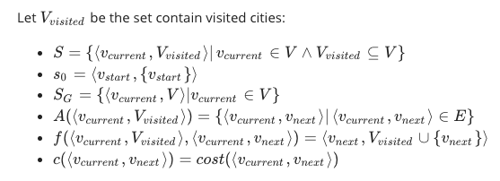
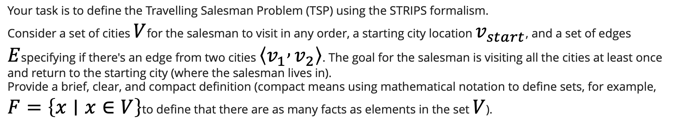
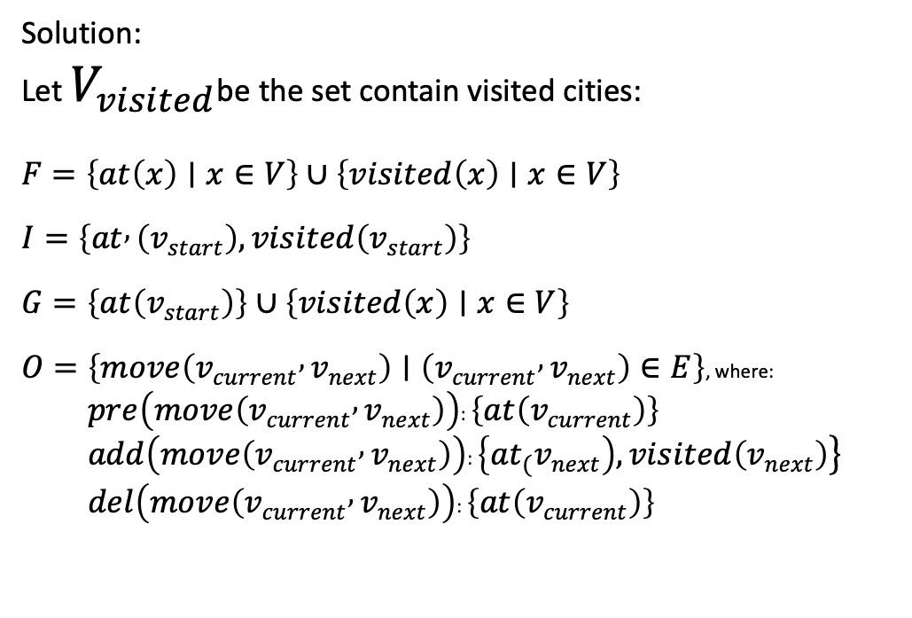
Your task is to define the Travelling Salesman Problem (TSP) using the STRIPS formalism.
Consider a set of cities $V$for the salesman to visit in any order, a starting city location $v_{start}$, and a set of edges $E$specifying if there's an edge from two cities $\left\langle v_{1} , v_{2}\right\rangle$. The goal for the salesman is visiting all the cities at least once and return to the starting city (where the salesman lives in).
Provide a brief, clear, and compact definition (compact means using mathematical notation to define sets, for example, $F=\left\{x∣x∈V\right\}$to define that there are as many facts as elements in the set $V$).
Solution:
Let $V_{visited}$be the set contain visited cities:
$$F=\left\{at\left(x\right)∣x∈V\right\}∪\left\{visited\left(x\right)∣x∈V\right\}$$
$$I=\left\{at , \left(v_{start}\right),visited\left(v_{start}\right)\right\}$$
$$G=\left\{at\left(v_{start}\right)\right\}∪\left\{visited\left(x\right)∣x∈V\right\}$$
$O=\left\{move\left(v_{current} , v_{next}\right)∣\left(v_{current} , v_{next}\right)∈E\right\}$, where:
  $pre\left(move\left(v_{current} , v_{next}\right)\right)$: $\left\{at\left(v_{current}\right)\right\}$
  $add\left(move\left(v_{current} , v_{next}\right)\right)$: $\left.\left\{at_{\left.(\right.}v_{next}\right),visited\left(v_{next}\right)\right\}$
  $del\left(move\left(v_{current} , v_{next}\right)\right)$: $\left\{at\left(v_{current}\right)\right\}$

Slide 7
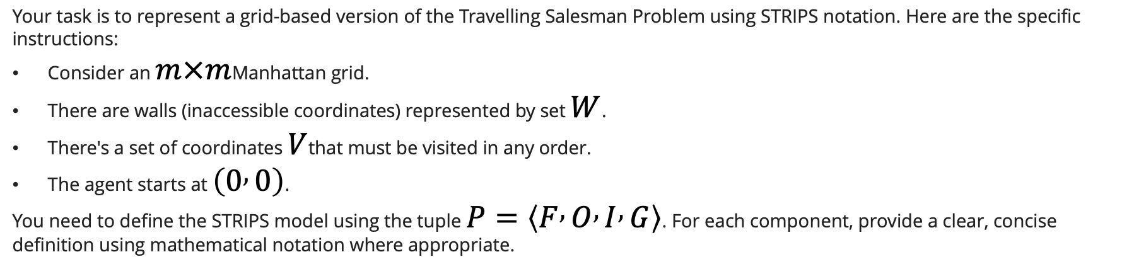
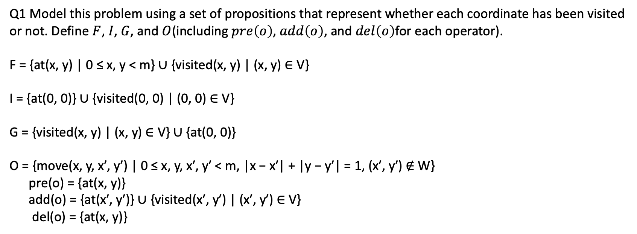
Your task is to represent a grid-based version of the Travelling Salesman Problem using STRIPS notation. Here are the specific instructions:
Consider an $m×m$Manhattan grid.
There are walls (inaccessible coordinates) represented by set $W$.
There's a set of coordinates $V$that must be visited in any order.
The agent starts at $\left(0 , 0\right)$.
You need to define the STRIPS model using the tuple $P=\left\langle F , O , I , G\right\rangle$. For each component, provide a clear, concise definition using mathematical notation where appropriate.
Q1 Model this problem using a set of propositions that represent whether each coordinate has been visited or not. Define $F$, $I$, $G$, and $O$(including $pre\left(o\right)$, $add\left(o\right)$, and $del\left(o\right)$for each operator).
F = {at(x, y) | 0 ≤ x, y < m} ∪ {visited(x, y) | (x, y) ∈ V}
I = {at(0, 0)} ∪ {visited(0, 0) | (0, 0) ∈ V}
G = {visited(x, y) | (x, y) ∈ V} ∪ {at(0, 0)}
O = {move(x, y, x′, y′) | 0 ≤ x, y, x′, y′ < m, |x − x′| + |y − y′| = 1, (x′, y′) ∉ W}
pre(o) = {at(x, y)}
add(o) = {at(x′, y′)} ∪ {visited(x′, y′) | (x′, y′) ∈ V}
del(o) = {at(x, y)}

Slide 8
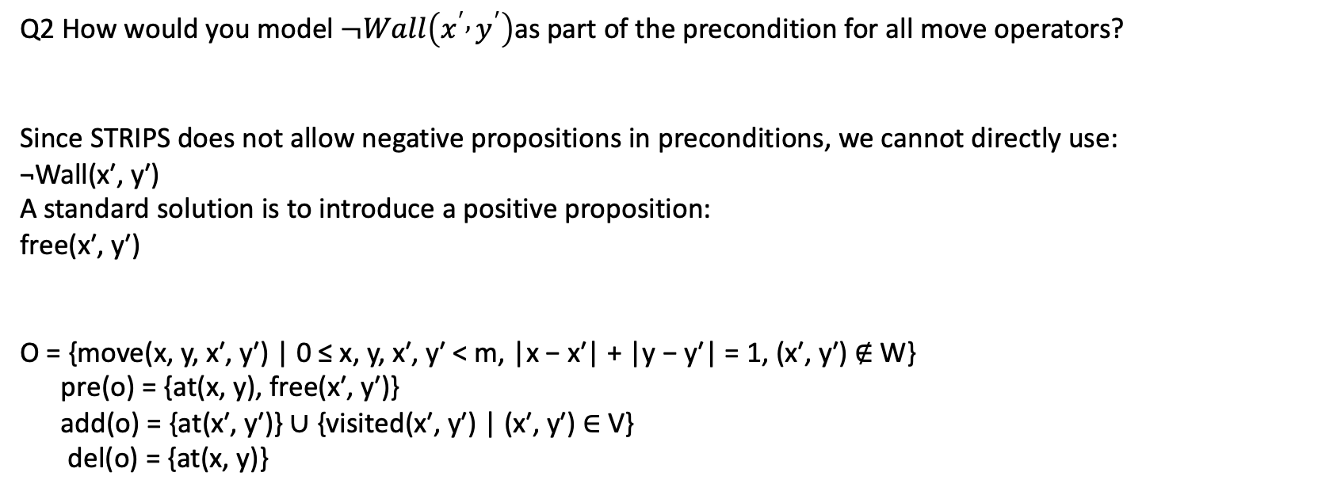
Your task is to represent a grid-based version of the Travelling Salesman Problem using STRIPS notation. Here are the specific instructions:
Consider an $m×m$Manhattan grid.
There are walls (inaccessible coordinates) represented by set $W$.
There's a set of coordinates $V$that must be visited in any order.
The agent starts at $\left(0 , 0\right)$.
You need to define the STRIPS model using the tuple $P=\left\langle F , O , I , G\right\rangle$. For each component, provide a clear, concise definition using mathematical notation where appropriate.
Q2 How would you model $¬Wall\left(x^{′} , y^{′}\right)$as part of the precondition for all move operators?
Since STRIPS does not allow negative propositions in preconditions, we cannot directly use:
¬Wall(x′, y′)
A standard solution is to introduce a positive proposition:
free(x′, y′)
O = {move(x, y, x′, y′) | 0 ≤ x, y, x′, y′ < m, |x − x′| + |y − y′| = 1, (x′, y′) ∉ W}
pre(o) = {at(x, y), free(x′, y′)}
add(o) = {at(x′, y′)} ∪ {visited(x′, y′) | (x′, y′) ∈ V}
del(o) = {at(x, y)}

Slide 9
Q2 Try to model this problem using propositions that represent coordinates the agent needs to visit but hasn't visited yet.
If this is possible, explain how. If not, explain why not. Consider the generalisability of your approach.
We can use propositions of the form:
unvisited(x, y)
The initial state would include:
I = {at(0, 0)} ∪ {unvisited(x, y) | (x, y) ∈ V and (x, y) ≠ (0, 0)}
However, this representation cannot express the goal directly in standard STRIPS. The intended goal would be:
¬unvisited(x, y) for every (x, y) ∈ V

Slide 10

A blocks-world problem
A
A
B
C
B
C
Table
Table
Initial situation
Goal situation
In blocks-world, the agent’s aim is to stack the blocks in one tower with A on B and B on C.
The agent can hold up to one block at a time and can put a block down on the table, or another block.

Slide 11
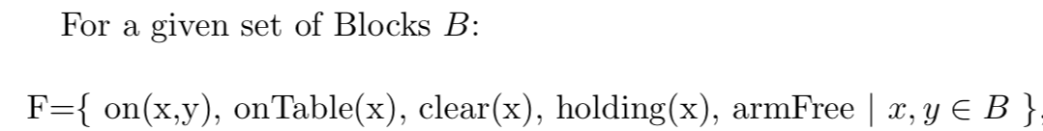
A blocks-world problem
A
C
B
Table
1. Define the set of facts F

Slide 12

A blocks-world problem
1. Define the set of facts F
A
C
B
2. Define operators(actions) O
The agent can hold up to one block at a time and can put a block down on the table, or another block
Table
Just pick up from table:
pickup(x)
Notes:
pickup(pick up from table)

Slide 13



A blocks-world problem
1. Define the set of facts F
A
C
B
2. Define operators(actions) O
The agent can hold up to one block at a time and can put a block down on the table, or another block
Table
Just pick up from table:
pickup(x)
Notes:
pickup(pick up from table)

Slide 14
A blocks-world problem
1. Define the set of facts F
A
C
B
2. Define operators(actions) O
Table
2) Pick up from another block:
unstack (x, y)

Slide 15



A blocks-world problem
1. Define the set of facts F
A
C
B
2. Define operators(actions) O
Table
2) Pick up from another block:
unstack (x, y)

Slide 16



A blocks-world problem
1. Define the set of facts F
B
A
C
2. Define operators(actions) O
Table
3) Put down on table:
putdown (x)

Slide 17



A blocks-world problem
A
1. Define the set of facts F
C
B
2. Define operators(actions) O
Table
4) Put down on another block:
stack (x, y)

Slide 18

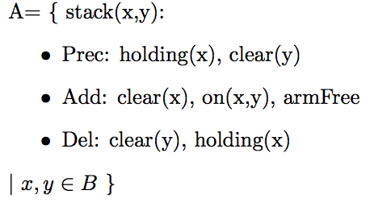
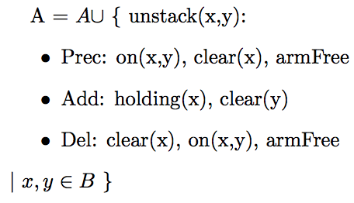
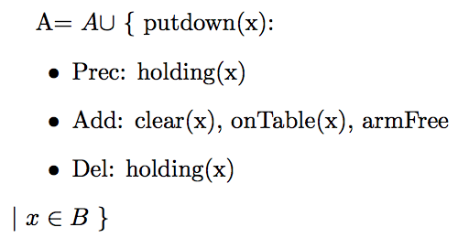
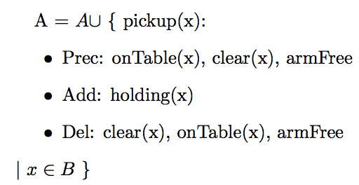

A blocks-world problem
F
A
O
C
B
Table
I
G
G =
Notes:
4 operators here, we can also define this problem using just 2 operators.

Slide 19
2 actions
Blocks-world can be modeled with only 2 actions instead of 4.
The robot can pick up a block and put it down on another block (or the table) in a single action.
2 actions in total:
Move1(Block, FromTable ,ToBlock) and Move2(Block, FromBlock, ToTable)
You now no longer need to keep track of what the robot is holding or if the hand is empty

Slide 20
Objectives
2.PDDL

Slide 21
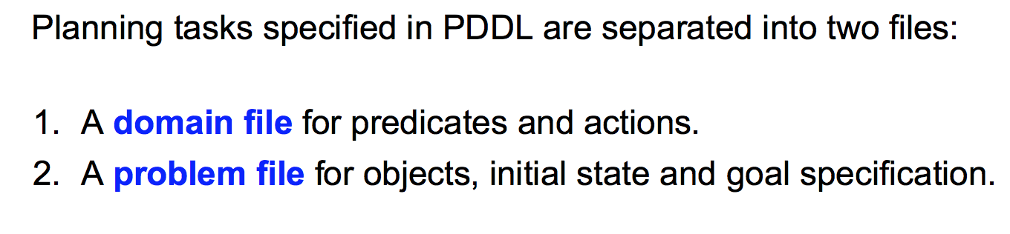
PDDL
A common language for writing STRIPS domain and problem sets is the Planning Domain Definition Language (PDDL).

Slide 22
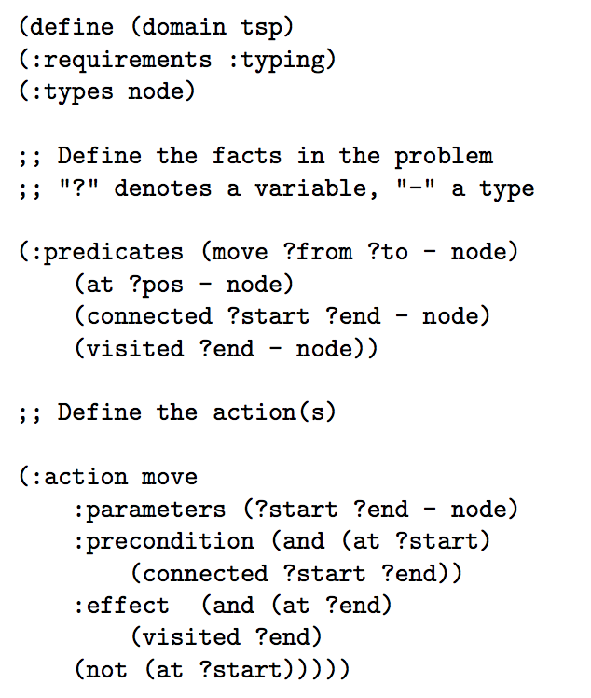
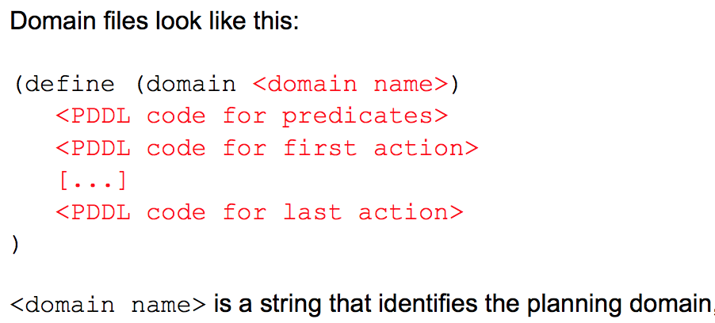
PDDL
Travelling Salesman Problem
1.Domain file

Slide 23
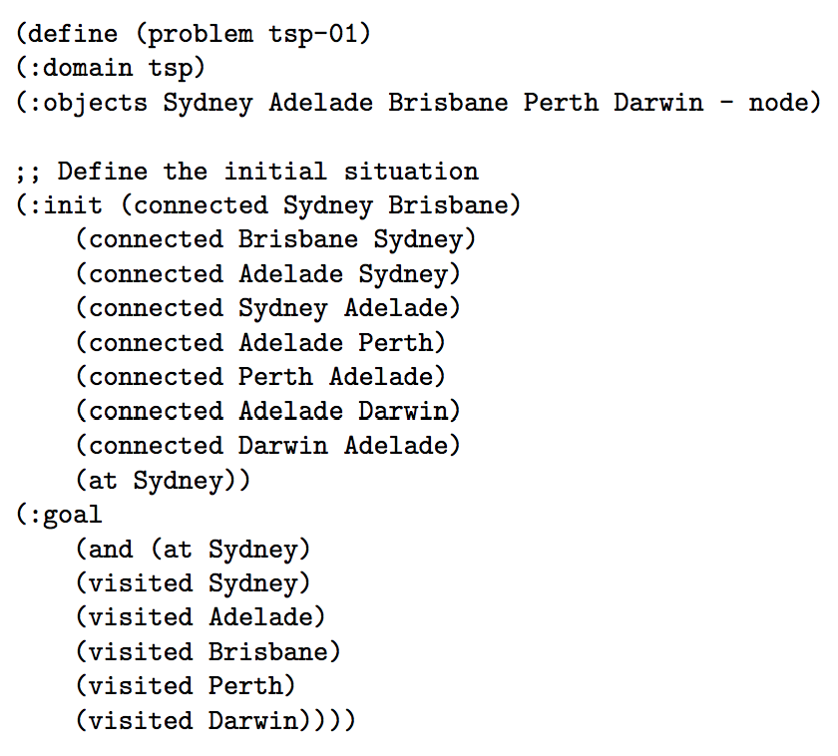
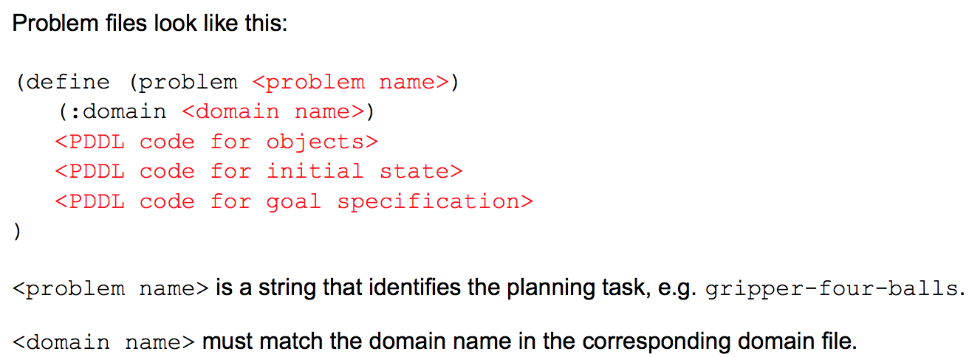
PDDL
Travelling Salesman Problem
2.Problem file

Slide 24
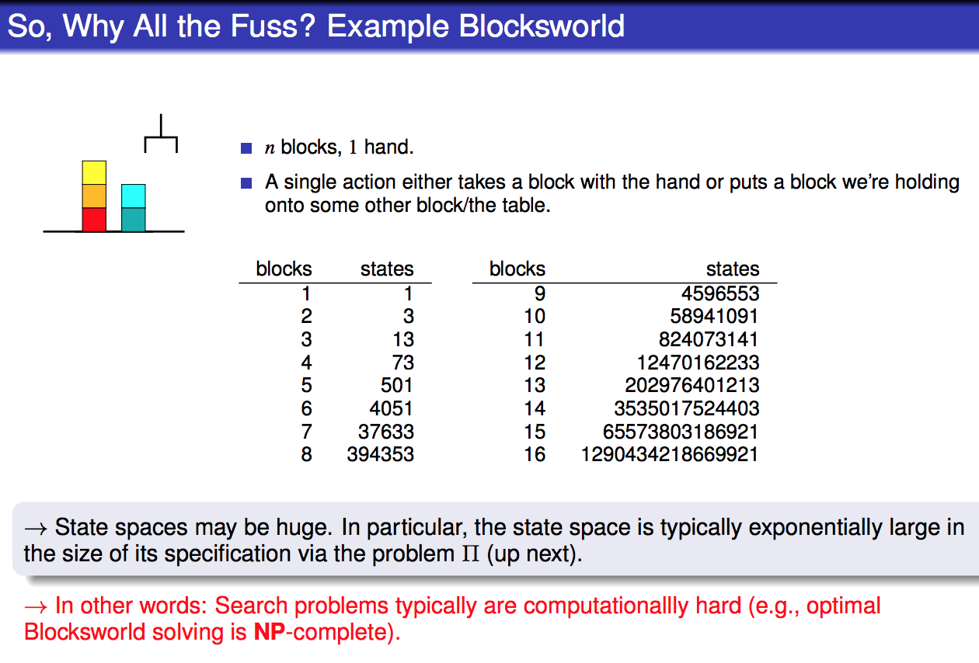

Slide 25
PDDL online editor
http://editor.planning.domains

Slide 26
Solution:
2 actions; 4 actions
http://editor.planning.domains/#read_session= TYXYMCQN8w

